Slide 1
An Investigation of Conformal Meshing Through Dual Contouring of Hermite Data
MASTERS THESIS
Presented By:
Parth DESAI (1381870)
M.Sc. High Integrity Systems
Supervisors:
Prof. Dr. Peter THOMA
Prof. Dr. Karsten WERONEK
Fachbereich 2 Informatik und Ingenieurwissenschaften

Slide 2
Agenda
Introduction
Analysis of Algorithms
Intel Embree integration
Quadratic Error Function
Implementation
Results and Discussion
Conclusion
Future Scope

Slide 3
Introduction
Scientific Visualization: A critical tool across domains, transforming complex data into insightful visual models.
Mesh Generation: Central technique for representing volume data; increasing demand due to growing data complexity.
Isosurface Extraction: Promising subset of mesh generation, but with challenges in Hermite data and conformal meshing.
Research Focus: Dive deep into isosurface extraction techniques, their strengths, limitations, and optimization potential.
Core Problem: Efficiently and accurately transform complex volume data into meaningful geometric models for diverse applications.

Slide 4
Research Objective
To understand the challenges and intricacies of conformal meshing through
Hermite data.
• To explore and evaluate the performance of Dual Contouring and Dual Marching
Cubes algorithms in isosurface extraction.
• To integrate and utilize the Intel Embree library for efficient ray tracing.
• To delve into the Quadratic Error Function’s methodology and its significance
in the chosen algorithms.

Slide 5
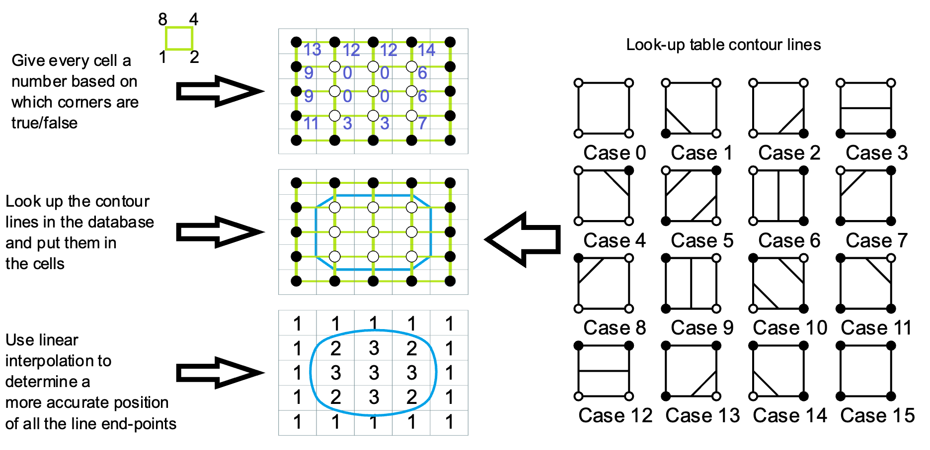
Marching Squares (MS)
A 2D contouring algorithm that divides data into grid squares evaluates vertex values against a look-up table.
Image credit: https://en.wikipedia.org/wiki/Marching_squares#/media/File:Marching_squares_algorithm.svg

Slide 6
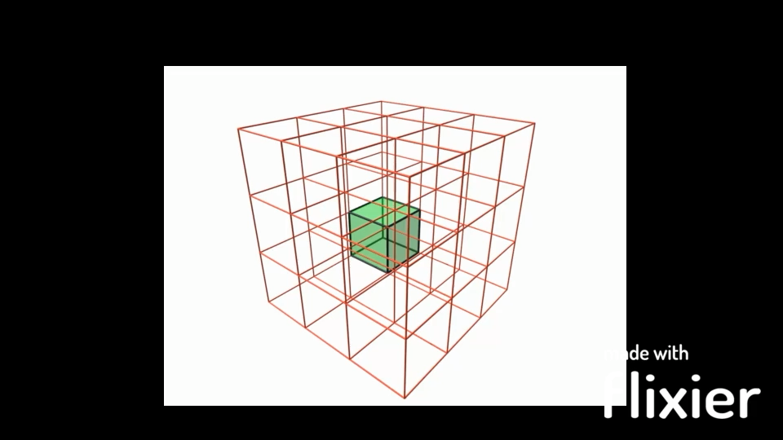
Marching Cubes (MC)
A 3D extension of Marching Squares.
Divide a cube into eight regions.
256 cases instead of 16 cases in MS.
Assign scalar field value to each corner.
Generate polygons w.r.to look-up table.
Video credit: https://makeagif.com/i/CFGhlJ
Pros
Cons
Easy to implement
Loss of sharp feature
Super fast (Gold standard)
Loss of thin feature
Manifold mesh
Limited of fixed grids

Slide 7
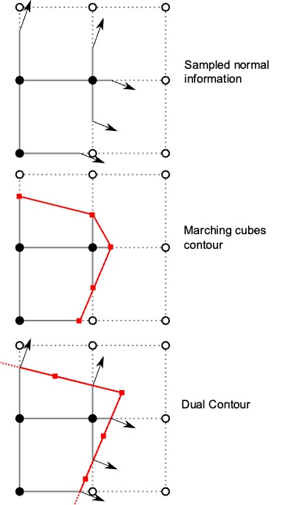
Dual Contouring (DC)
Place the vertex in the cell rather than on the edge like MC.
Divides a 3D grid into cells and computes intersections and normals along each edge.
Find the ideal vertex for each cell.
Connect the vertices to form quadrilaterals.
Pros
Cons
Sharp features
Difficult to implement
Adaptive
Loss of thin feature
Minimize silver polygon
Non-manifold mesh

Slide 8
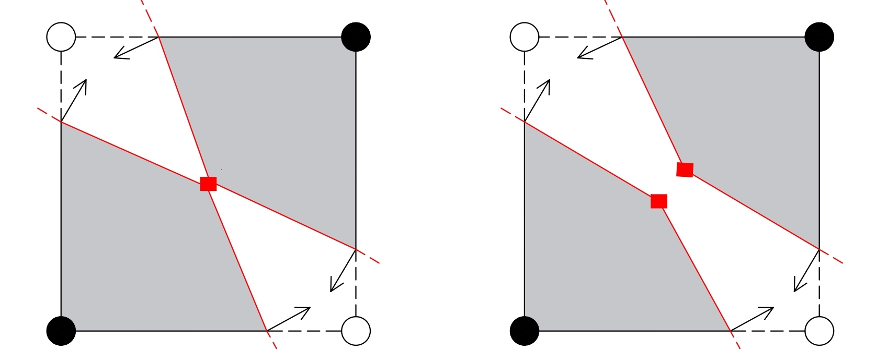
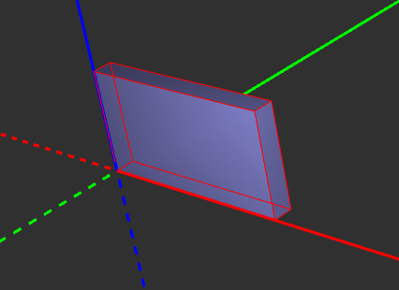
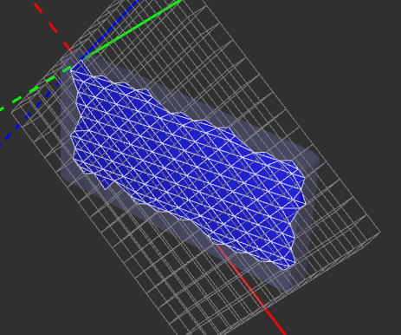
Dual Contouring Limitations
Allows only one vertex per cell leading into the non-manifold.
Not able to generate thin features with comparatively sparse mesh.

Slide 9
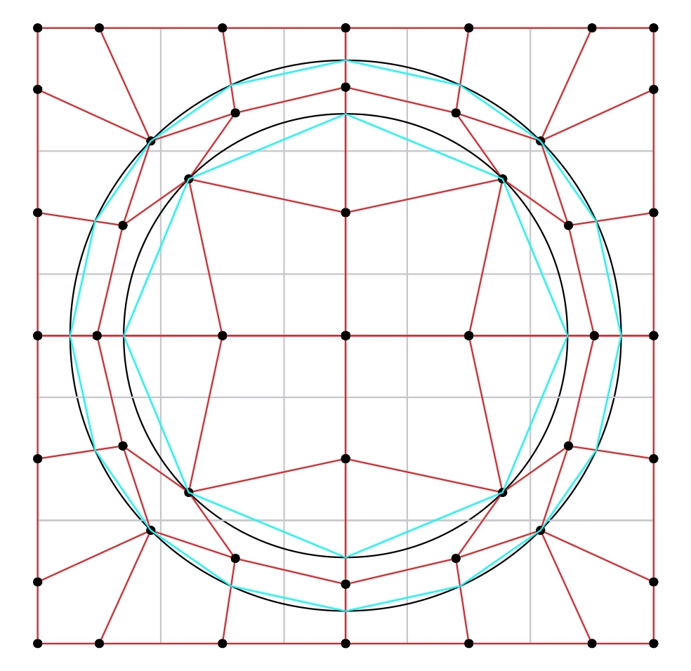
Dual Marching Cubes (DMC)
Combines strengths of Dual Contouring and Marching Cubes.
Uses the vertices generated by DC.
Construct the dual grid.
MC applied on this dual grid.
Pros
Cons
Sharp & thin features
Hard to implement
Manifold mesh
Computational intensity
Adaptive
Difficult for real-time application

Slide 10
Comparative Analysis
 | MS | MC | DC | DMC
Easy to implement | ++ | - | - | -
Local independence | + | + | - | -
Smooth | - | + | + | +
Adaptive | - | - | + | +
Minimize silvers | + | - | + | +
Sharp features | - | - | + | +
Thin features | - | - | - | +

Slide 11
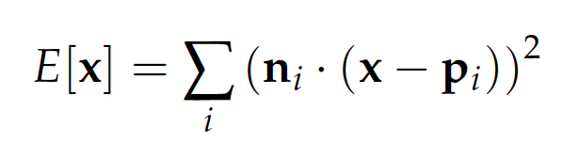
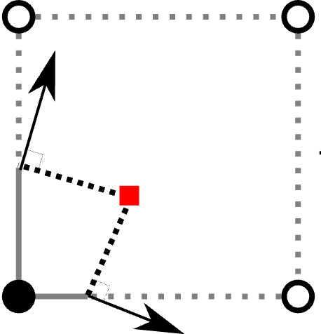
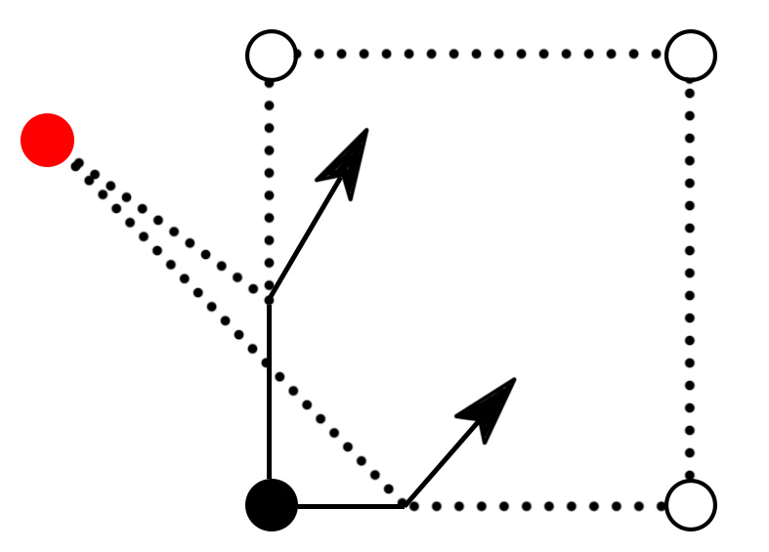
Quadratic Error Function (QEF)
Heart of the Dual Contouring and Dual Marching Cubes algorithm.
Used to find the optimal point inside each cell that minimizes the distance to the hit points and the normals.
Extrapolate normals to find the vertex of best fit
ni are the normals,
pi are the positions, and
x is the minimization point.
Challenges:
Empty or parallel normal
Point outside the cell.
Large flat surfaces
The minimization point is outside the cell

Slide 12
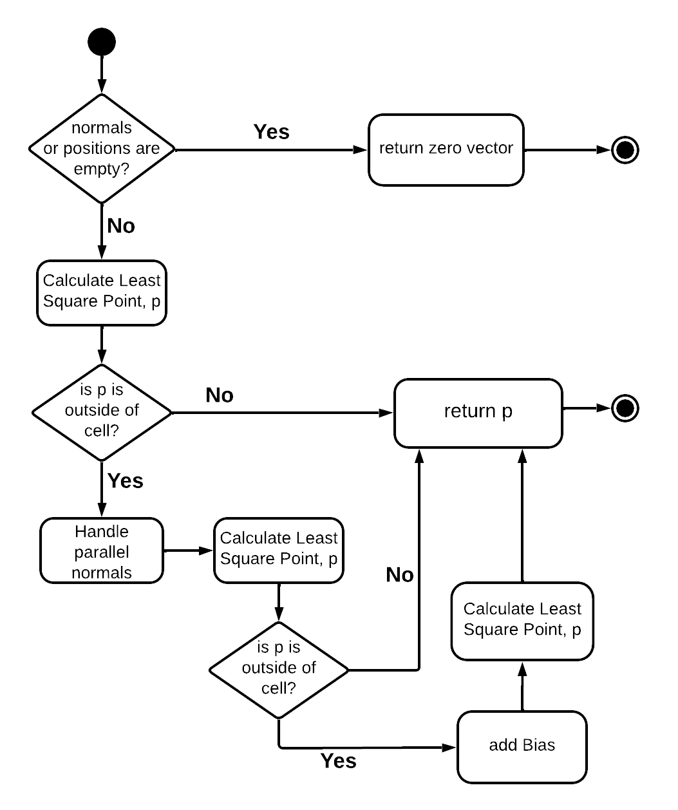
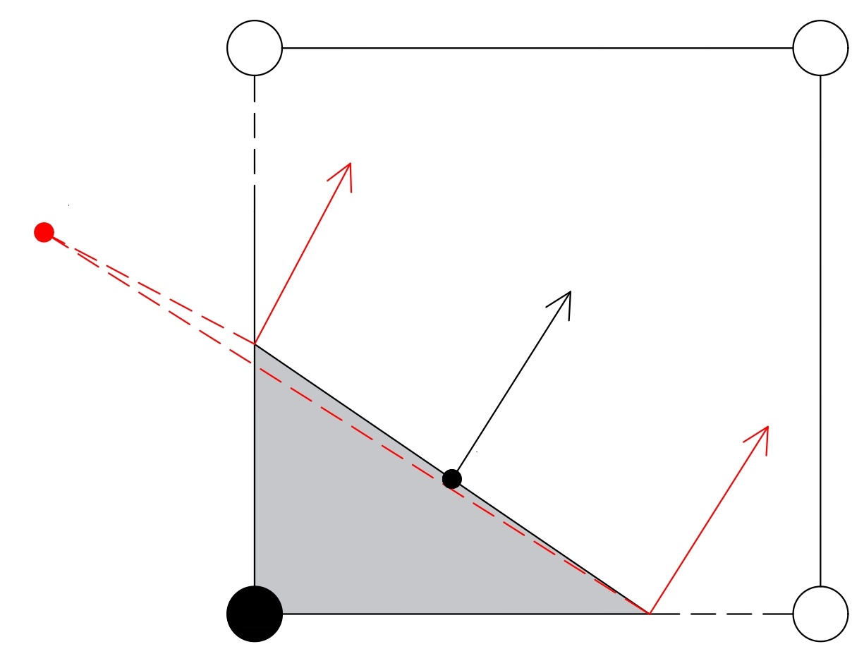
QEF Flowchart
Parallel normal?
What?
Why it happens?
How to tackle it?

Slide 13
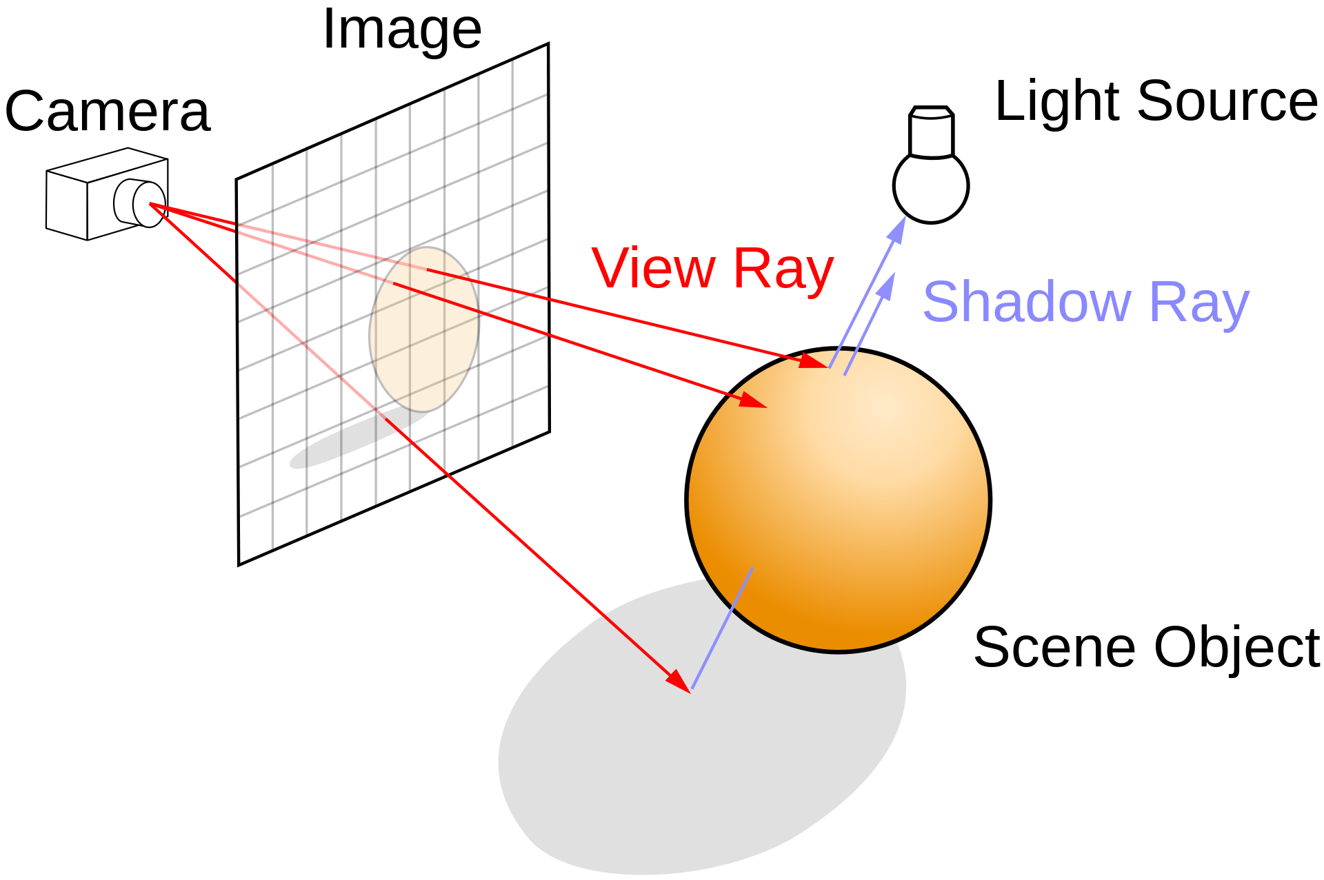
Intel Embree integration
A collection of highly optimized ray-tracing kernels that offer flexible and effective methods for ray-tracing
Why?
Open source under Apache 2.0
High performance and scalability
Easy integration and customization
Robust and reliable
What for?
Find the Intersection points.
Calculate the normals.
Populate the core data structures.

Slide 14
Implementation
Heart of the Dual Contouring and Dual Marching Cubes algorithm

Slide 15
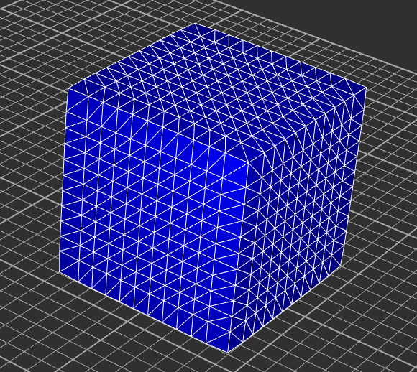
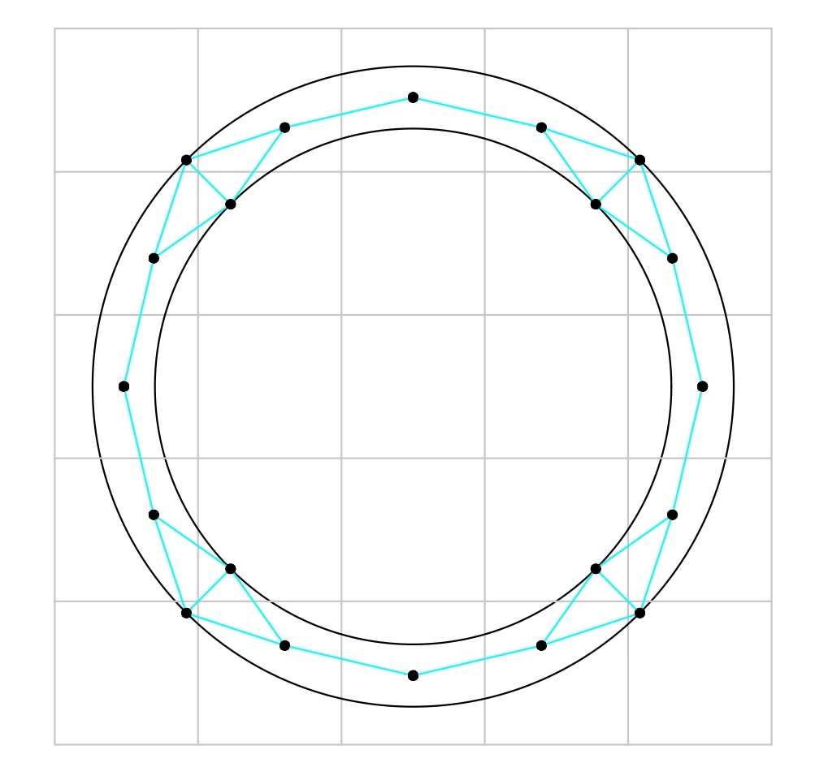
Results
Dual Contouring algorithm
Produced high-quality meshes
Able to maintain sharp features
Not able to generate thin features
However, generated non-manifold surface due to,
Large flat surfaces.
Inability to place multiple vertices in a single cell.
Multiple objects in close proximity.

Slide 16
Results
Dual Marching Cubes algorithm
Produced high-quality meshes
Able to maintain both sharp & thin features.
However, DMC is computationally heavy due to,
Calculation of the Dual grid
Requires implementation of both DC & MC.
Original surface (Thin ring) in black
DMC surface shown by Cyan lines
Greyline - Primal grid
Redline – Dual grid
Black point – point calculated by QEF

Slide 17
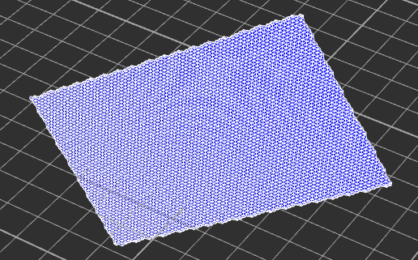
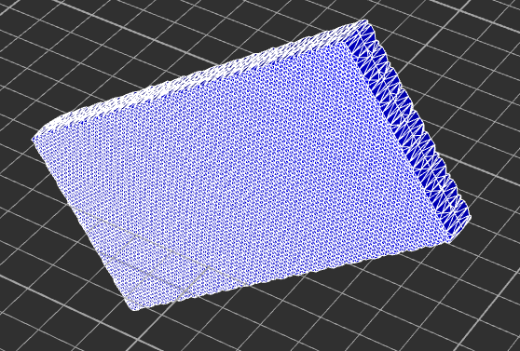
Results
DC not able to generate thin features with comparatively sparse mesh.
1. Thin brick
2. DC algorithm with sparse grid
3. DC algorithm with Dense grid
4. DMC (able to reproduce thin brick)

Slide 18
Conclusion
Comprehensive exploration of Dual Contouring (DC) and Dual Marching Cubes (DMC) algorithms.
DC excels in preserving sharp features; DMC efficiently represents thin structures.
Both algorithms are pivotal in isosurface extraction; choice depends on application requirements.
The current implementation has areas for improvement: loop optimization, data structure refinement, and QEF limitations.

Slide 19
Future work
Data Structure Optimization:
The transition from a 3D nested vector to an efficient single-dimensional array.
Enhanced QEF Implementation:
Address points outside desired cells without mere boundary clamping.
Adaptive Grids:
Investigate octree grids for refined regions of interest.
Optimization Techniques:
Harness parallel processing and GPU capabilities.
Machine Learning Integration:
Predict vertex placements and guide the extraction process.

Slide 20
Questions?

